Slide 1

Computer Networks
Domain Name System
S.V.Jansi Rani
Associate Professor / CSE

Slide 2
AGENDA
Domain Name System
Need
Domain, Zones and Name Servers
Resolution
Iterative Resolution
Recursive Resolution
Caching
Message Format

Slide 3



Slide 4
Domain Name System
Internet is so huge -central directory system cannot hold all the mapping- fails – collapse
Solution - distribute the information
Host that needs mapping can contact the closest computer
holding the needed information -Domain Name System (DNS)

Slide 5
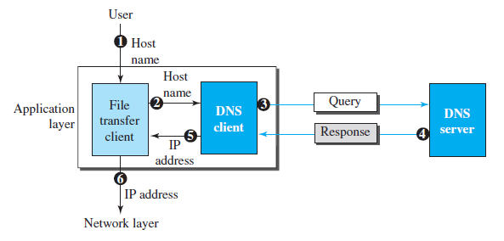
Example of using the DNS service

Slide 6
NAME SPACE
To be unambiguous, the names assigned to machines must be carefully selected from a name space with complete control over the binding between the names and IP addresses.
Flat Name Space Hierarchical Name Space
several parts – nature, org, dept
jansi.ssn.edu , jansi.annauniv.edu -> different

Slide 7
DOMAIN NAME SPACE
To have a hierarchical name space, a domain name space was designed. In this design the names are defined in an inverted-tree structure with the root at the top. The tree can have only 128 levels: level 0 (root) to level 127.
Label –max 63 char, root node-null, children- unique name Domain Name – node to root Domain

Slide 8
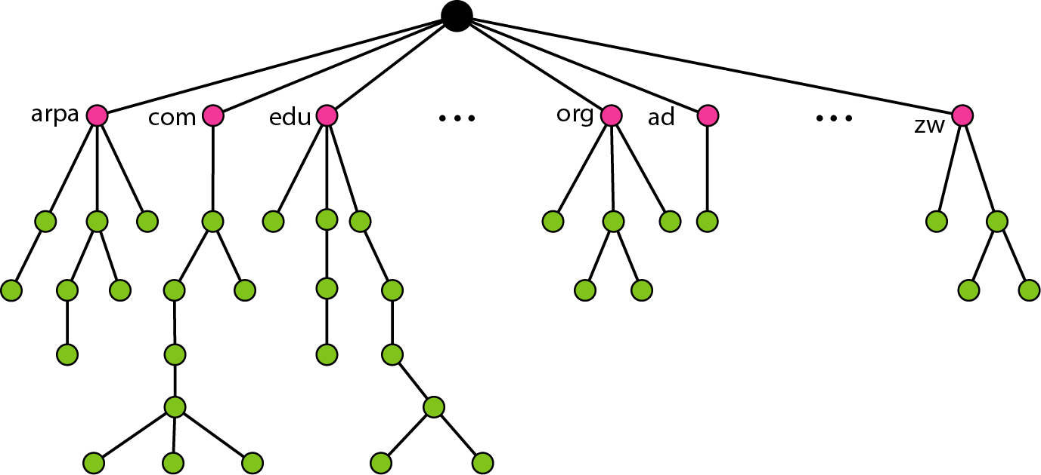
Domain name space

Slide 9
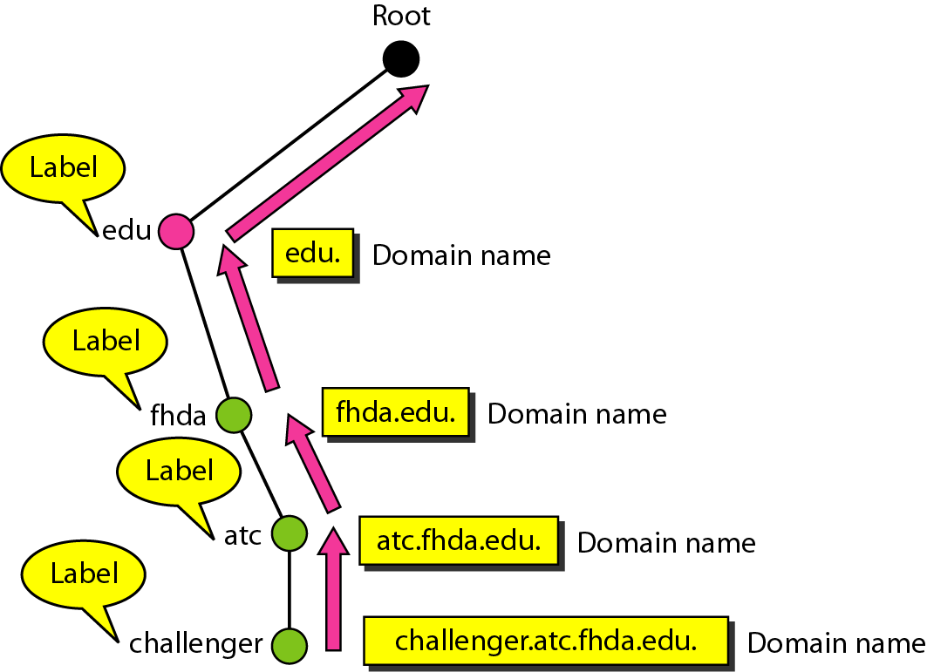
Domain names and labels

Slide 10
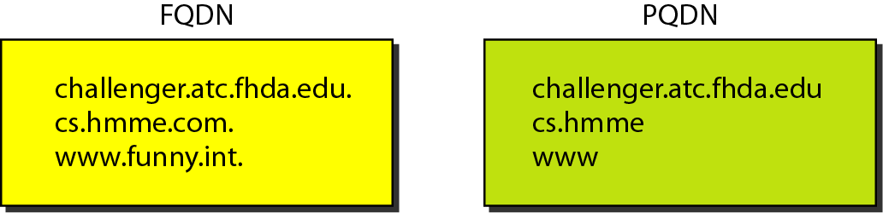
FQDN and PQDN

Slide 11
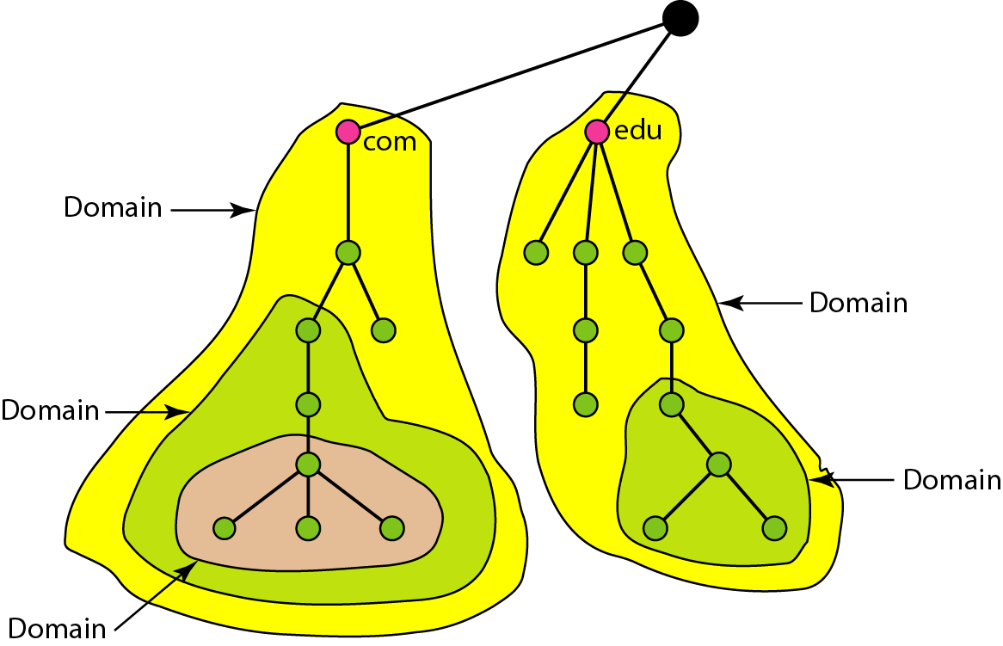
Domains

Slide 12
DISTRIBUTION OF NAME SPACE
The information contained in the domain name space must be stored. However, it is very inefficient and also unreliable to have just one computer store such a huge amount of information. In this section, we discuss the distribution of the domain name space.
Topics discussed in this section:
Hierarchy of Name Servers
Zone Root Server Primary and Secondary Servers

Slide 13
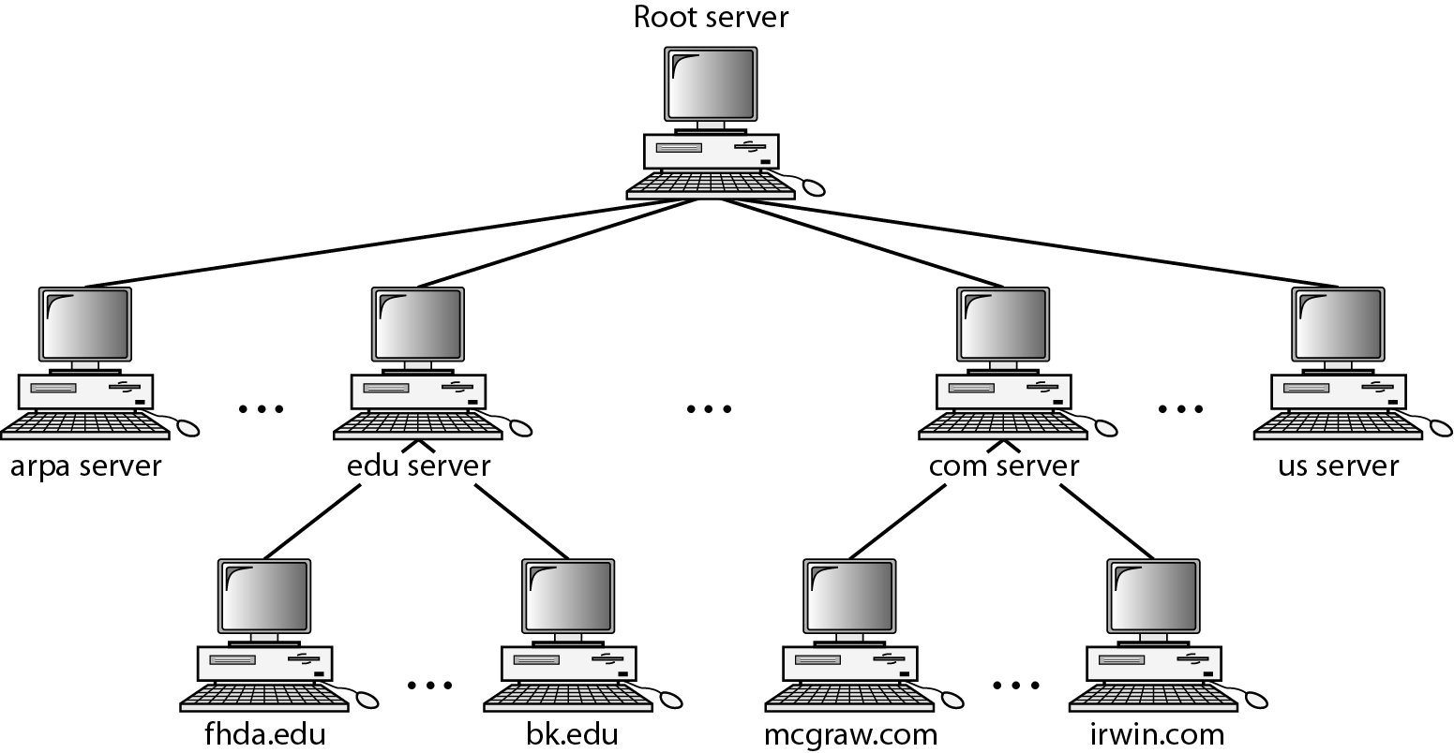
Hierarchy of name servers

Slide 14
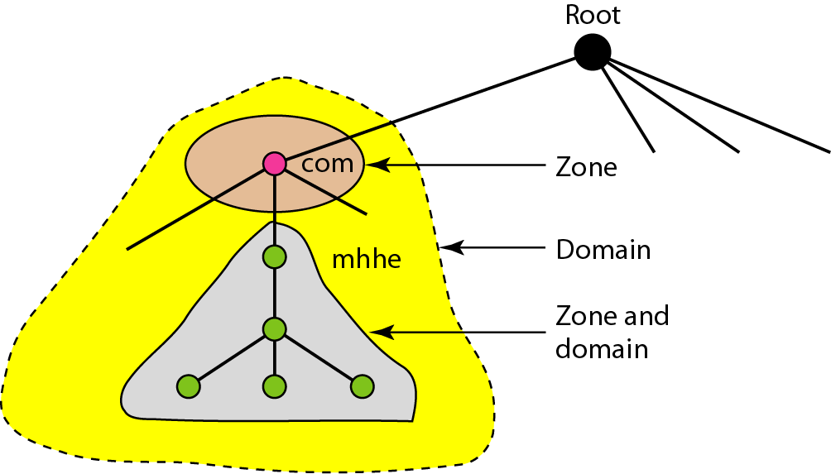
Zones and domains

Slide 15

Note
A primary server loads all information from the disk file; the secondary server
loads all information from the primary server.
When the secondary downloads
information from the primary, it is called zone transfer.

Slide 16
DNS IN THE INTERNET
DNS is a protocol that can be used in different platforms. In the Internet, the domain name space (tree) is divided into three different sections: generic domains, country domains, and the inverse domain.
Topics discussed in this section:
Generic Domains Country Domains Inverse Domain

Slide 17
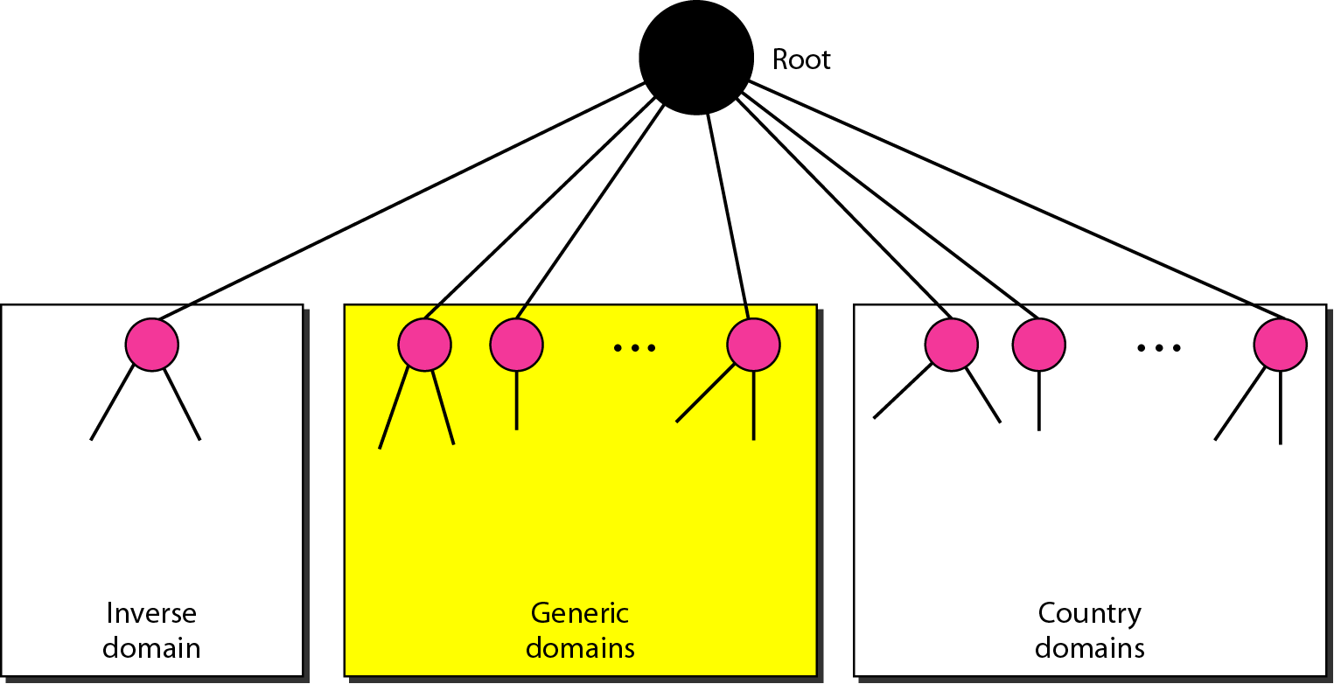
DNS IN THE INTERNET

Slide 18
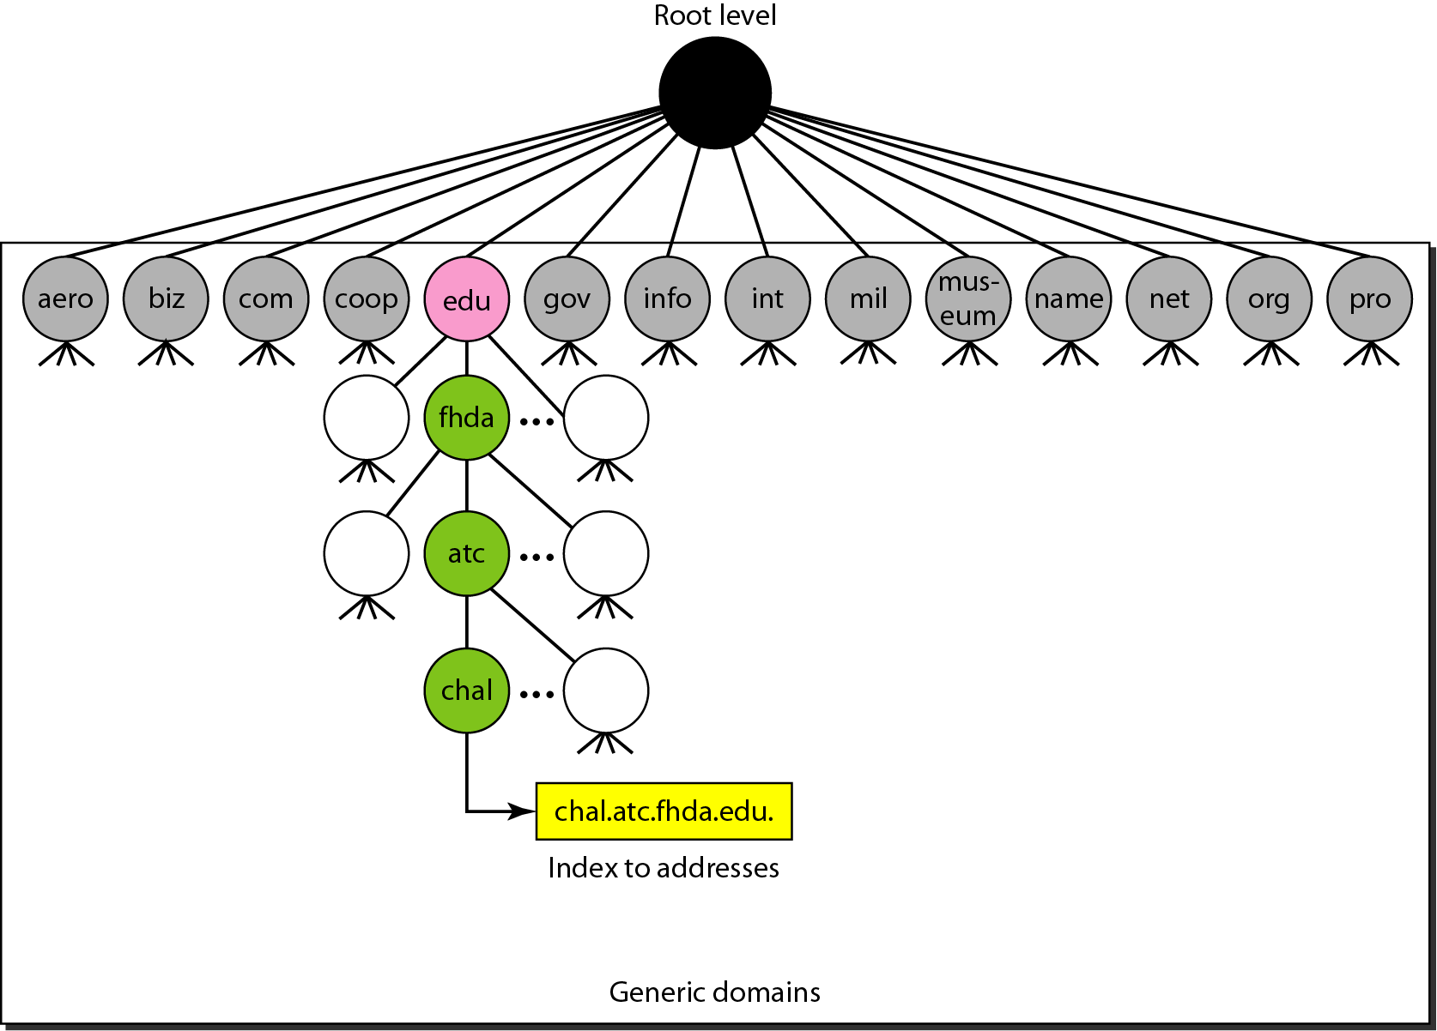
Generic domains

Slide 19
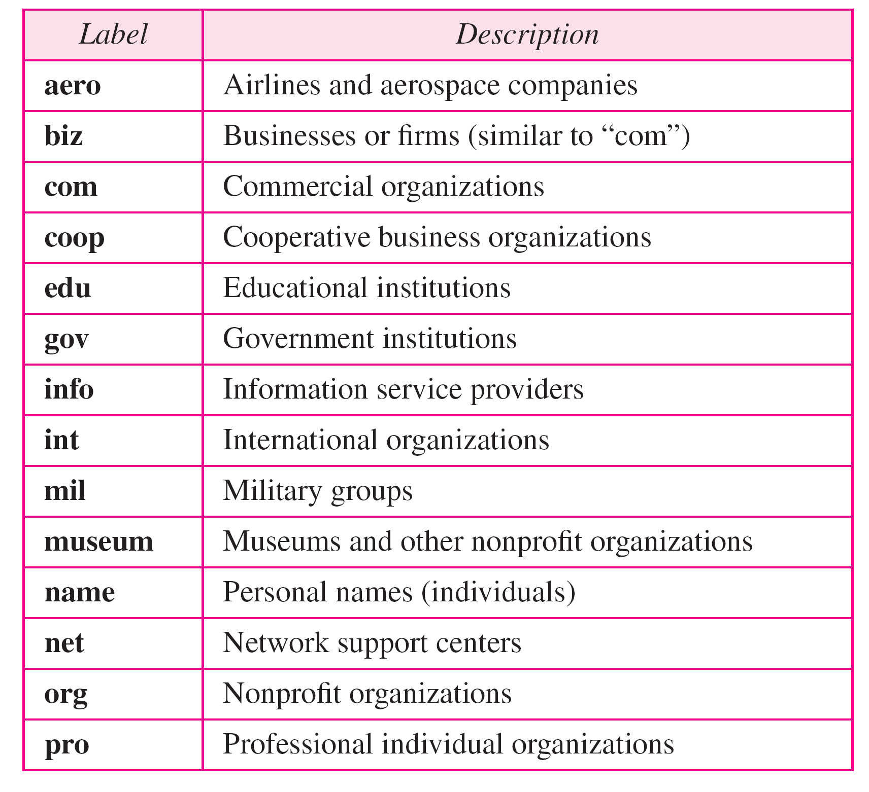
Generic domain labels

Slide 20
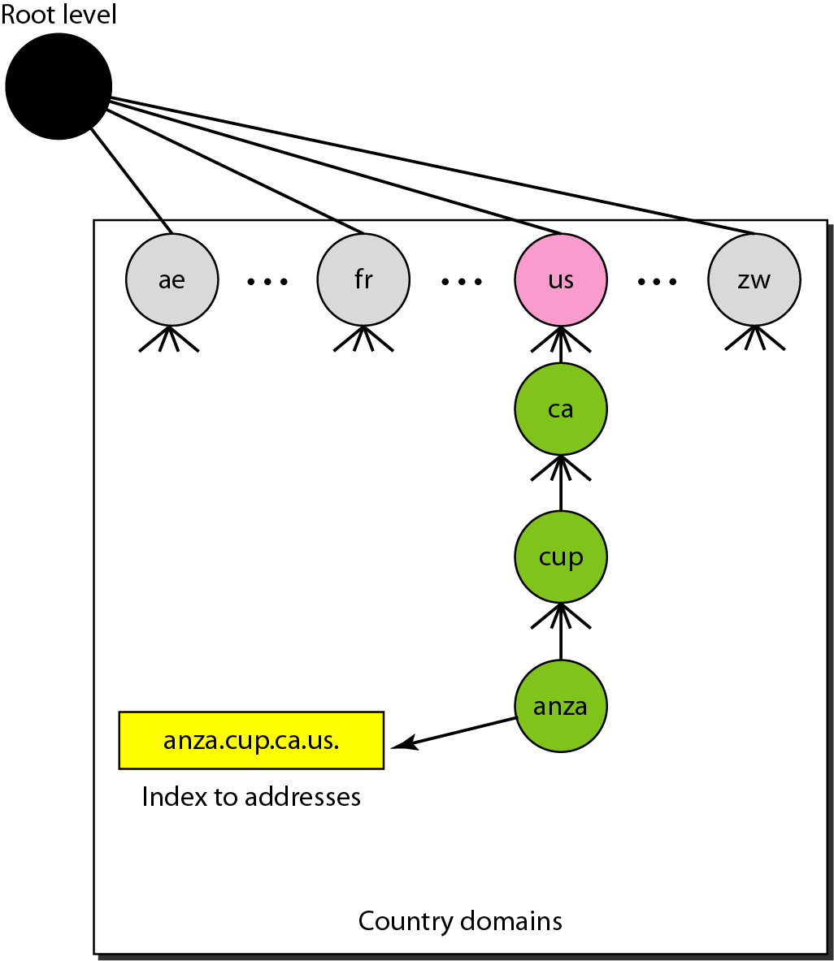
Country domains

Slide 21
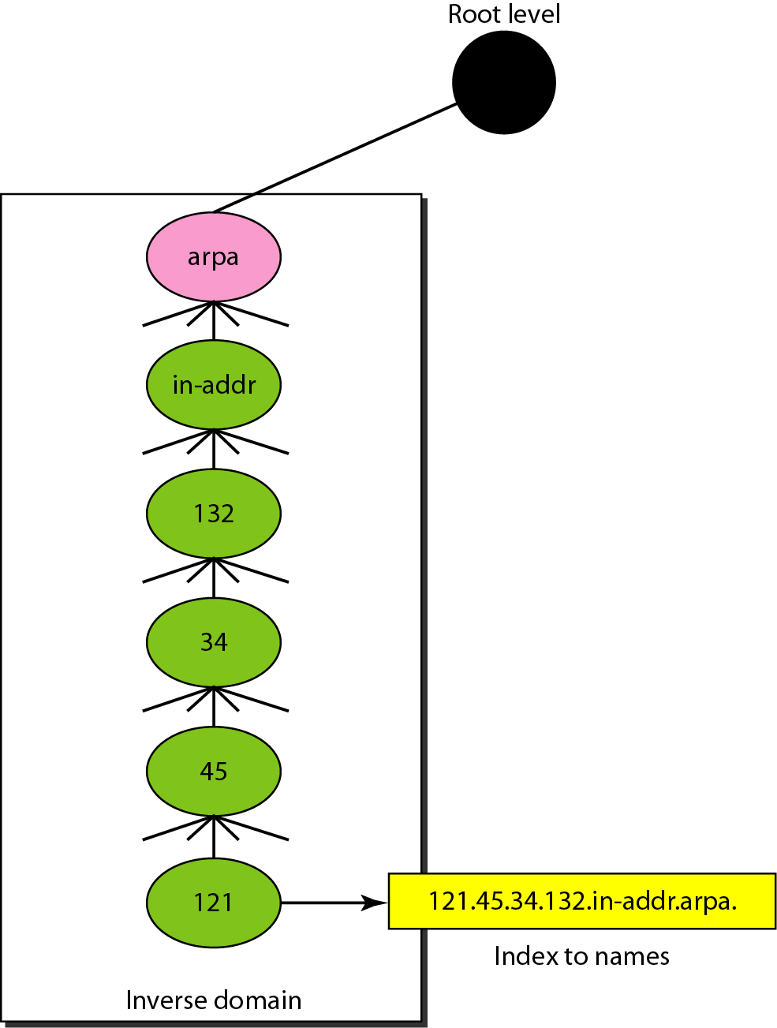
Inverse domain

Slide 22
RESOLUTION
Mapping a name to an address or an address to a name is called name-address resolution.
A host that needs to map an address to a name or a name to an address calls a DNS client called a resolver.
Topics discussed in this section:
Resolver Mapping Names to Addresses Mapping Addresses to Names
Recursive Resolution
Iterative Resolution
Caching

Slide 23
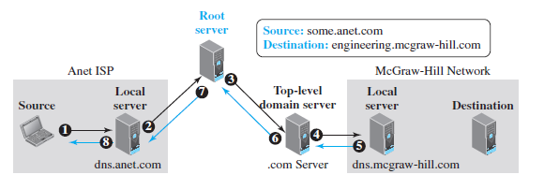
Recursive resolution

Slide 24
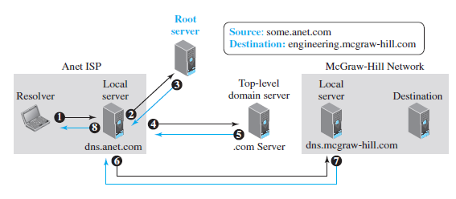
Iterative resolution

Slide 25
Caching
Server –cache reply –answers as unauthoritative
Authoritative server -time to live (TTL
DNS requires that each server keep a TTL counter

Slide 26
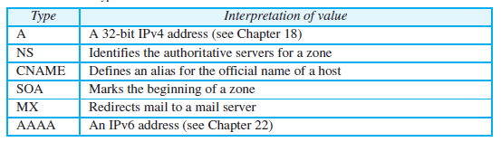
Resource Record
A resource record is a 5-tuple structure
(Domain Name, Type, Class, TTL, Value)

Slide 27
DNS MESSAGES
DNS has two types of messages: query and response. Both types have the same format.
Query message - header and question records
Response message - header, question records, answer records, authoritative records, and additional records.
Topics discussed in this section:
Header

Slide 28
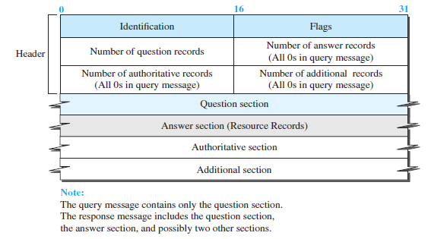
Query and response messages

Slide 29
Encapsulation
TCP/ UDP –port 53
Response msg -<512 bytes – uses UDP else TCP
$nslookup www.google.com
Used to find address/name mapping

Slide 30
REGISTRARS
How are new domains added to DNS?
Using registrar, a commercial entity accredited by ICANN.
Registrar - verifies that the requested domain name is unique -enters it into the DNS database - fee is charged.
The Internet Corporation for Assigned Names and Numbers is an American multistakeholder group and nonprofit organization responsible for coordinating the maintenance and procedures of several databases related to the namespaces and numerical spaces of the Internet, ensuring the network's stable and secure operation.

Slide 31
DYNAMIC DOMAIN NAME SYSTEM (DDNS)
The DNS master file must be updated dynamically. The Dynamic Domain Name System (DDNS) therefore was devised to respond to this need. In DDNS, when a binding between a name and an address is determined, the information is sent, usually by DHCP to a primary DNS server. The primary server updates the zone. The secondary servers are notified either actively or passively.

Slide 32
Check Your Understanding
What is the need for DNS?
What problem we get when we use flat name space.
Difference between iterative and recursive resolution

Slide 33
Outcome
Student should be able to understand
What is the need for DNS
Organizational structure of DNS
Domain, Zone and Root Server
Iterative and Recursive DNS resolution
Message Format
Caching

Slide 34
THANK YOU

